Slide 1


Project Risk Management
BAI3020

Slide 2

Project Risk Management?
Notes:
Risk management is about planning, identification, response planning and monitoring and controlling risks throughout the life cycle of the project.
The purpose of Risk Management is to increase the probability and impact of positive events, and decrease the probability and impact of negative events on the project.
Risk is something that may or may not happen.
Risks are either considered to be threats or opportunities to the project .
Approximately 90% of threats that are identified and investigated in the risk management process can be eliminated.
Class participation: provide examples of threats and opportunities, RISK,
Remember there are good risks, such as the equipment needed for the project came under budget – we call them opportunities.

Slide 3
The Importance of Project Risk Management
Project risk management is the art and science of identifying, analyzing, and responding to risk throughout the life of a project and in the best interests of meeting project objectives
Risk management is often overlooked in projects, but it can help improve project success by helping to:
select good projects
determining project scope
developing realistic estimates

Slide 4
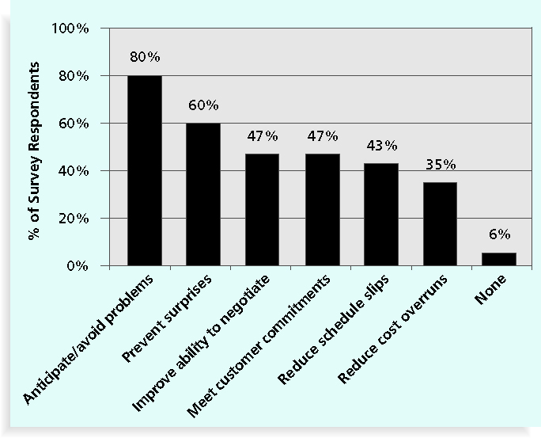
Benefits from Software Risk Management Practices*
*Kulik, Peter and Catherine Weber, “Software Risk Management Practices – 2001,” KLCI Research Group (August 2001).

Slide 5
Negative Risk
A dictionary definition of risk is “the possibility of loss or injury”
Negative risk involves understanding potential problems that might occur in the project and how they might impede project success
Negative risk management is like a form of insurance; it is an investment

Slide 6
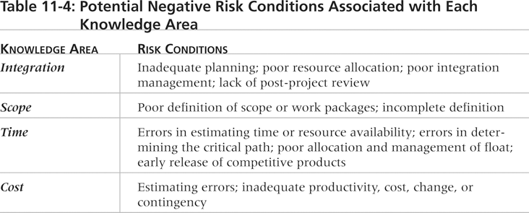
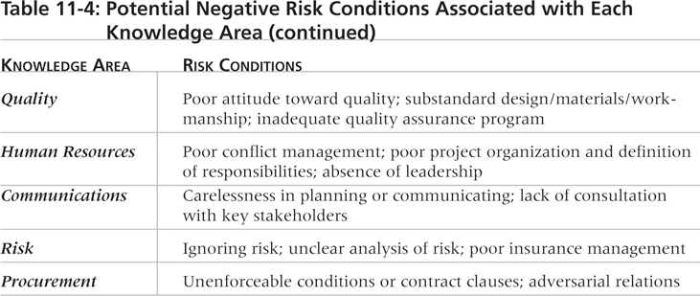
Potential Negative Risk Conditions Associated with Each Knowledge Area

Slide 7
Risk Can Be Positive
Positive risks are risks that result in good things happening; sometimes called opportunities
The goal of project risk management is to minimize (mitigate) potential negative risks while maximizing potential positive risks

Slide 8
Project Risk Management
TYPES OF RISK:
Pure Risk
the possibility that a person's house will be destroyed due to a natural disaster is pure risk Read more: http://www.investopedia.com/terms/p/purerisk.asp#ixzz2CE89J6jm
Business Risk
will experience a loss rather than a profit Read more: http://www.investopedia.com/terms/b/businessrisk.asp#ixzz2CE8nC1xM
Notes:
Pure risk is a risk for which insurance can be purchased thereby transferring the risk for financial benefit to the party accepting the risk.
Business risk is typically uninsurable – it is what business does when it opens its doors everyday for business. It’s the process of doing business. (e.g. when was the last time could buy insurance for sales projections?

Slide 9
Project Risk Management
RISK TOLERANCE:
Risk Adverse
Risk Seeker
Risk Neutral
Notes:
Risk adverse is a mentality of risk avoidance. Selecting the low risk item or a sure thing is the typical in this case.
Risk seeker is mentality looking for a risk.
Risk neutral is a middle ground mentality towards risk.

Slide 10
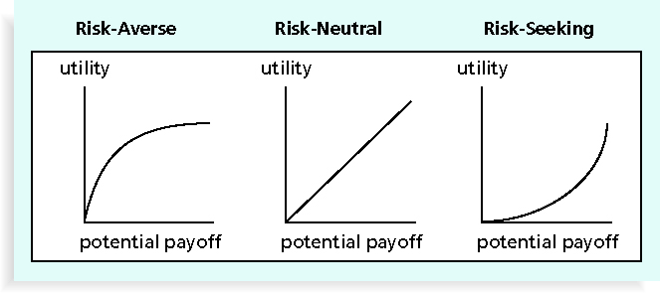
Risk Utility Function and Risk Preference

Slide 11
Project Risk Management
RISK CATEGORIES:
External
Internal
Market risk - Developing a new product or Service
Financial risk – Can the organization afford to run with the project
People Risk
Technical
Structure/process risk
Unforeseeable
Notes:
External – regulatory, environmental, government, market shift
Internal – time, cost, scope changes, inexperience, poor planning, people, staffing, materials and equipment
Technical – changes in technology
Unforeseeable – only a small portion of risks are actually unforeseeable.
Specific categories – cultural risks, stakeholder caused risks, sponsor caused risks, resistance to change
Categorize by source –quality risk, cost risk, schedule risk, HR risk and so forth.

Slide 12
Project Risk Management
Risk Factors:
The probability that it will occur (what)
The range of possible outcomes (impact or amount at stake)
Expected timing (when) in the project life cycle
Anticipate frequency of risk events from that source (how often)
Notes:
When looking at risk, one needs to determine: (powerpoint)

Slide 13
Project Risk Management
Risk Management Processes (6)
Planning:
1. Plan Risk Management
2. Identify Risks
3. Perform Qualitative Risk Analysis
4. Perform Quantitative Risk Analysis
5. Risk Response Planning
Monitoring and Controlling:
6. Monitor and Control Risks

Slide 14
Project Risk Management Processes
Planning risk management:
deciding how to approach and plan the risk management activities for the project
Identifying risks
determining which risks are likely to affect a project and documenting the characteristics of each
Performing qualitative risk analysis
What are the risks?
prioritizing risks based on their probability and impact of occurrence

Slide 15
Project Risk Management Processes (continued)
Performing quantitative risk analysis:
numerically estimating the effects of risks on project objectives
Planning risk responses:
taking steps to enhance opportunities and reduce (mitigate) threats to meeting project objectives
Monitoring and controlling risks:
monitoring identified and residual risks
identifying new risks
carrying out risk response plans
evaluating the effectiveness of risk strategies throughout the life of the project

Slide 16
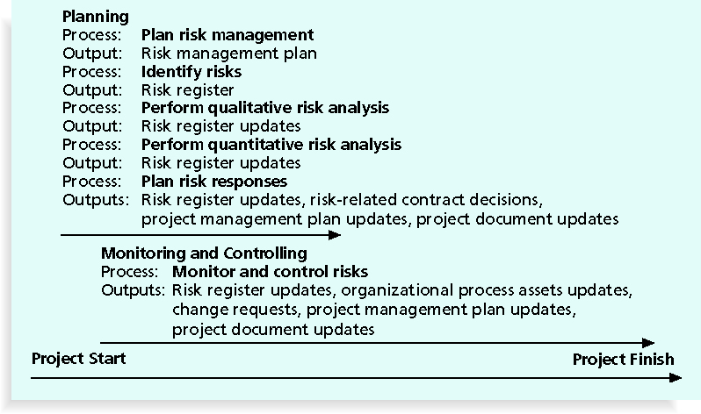
Project Risk Management Summary

Slide 17
Project Risk Management
Outputs of Risk Management Planning:
RISK MANAGEMENT PLAN
Notes:
A risk management plan may include? (ask the class)
Methodology – how you will perform risk management on a specific project.
Roles and responsibilities – who will do what and remember to also consider non-team members – the stakeholders
Timing – when to do risk management for a specific project.
Budgeting – includes the cost for the risk management process.
Risk categories – are defined
Definition of probability and impact – conducted in the qualitative risk analysis.
Stakeholder tolerances – e.g. if the stakeholder had low tolerance for cost overruns
Reporting formats – describes the type of forms, templates and reports that will be used in risk management on the specific project.
Tracking – this means how the risk process will be audited, and documenting what happens with risk management activities.

Slide 18
Topics Addressed in a Risk Management Plan
Methodology – how to perform on the project
Roles and responsibilities
Budget and schedule – for risk tasks
Risk categories
Risk probability and impact - to be assessed
How will team track risk activities
Risk documentation

Slide 19
Contingency and Fallback Plans, Contingency Reserves
Contingency plans are predefined actions that the project team will take if an identified risk event occurs
Fallback plans are developed for risks that have a high impact on meeting project objectives and are put into effect if attempts to reduce the risk are not effective
Contingency reserves or allowances are provisions held by the project sponsor or organization to reduce the risk of cost or schedule overruns to an acceptable level

Slide 20

Project Risk Management
RISK IDENTIFICATION:
Notes:
This is where risks are identified by
conducting documentation reviews, what is and what is not included in the preliminary project scope statement, charter and other plans
Brainstorming
Delphi Technique – a panel of content experts provide a response reached by consensus. This technique is also used for estimating cost and time
Interviewing
Root cause analysis
SWOT

Slide 21
Identifying Risks
Identifying risks is the process of understanding what potential events might hurt or enhance a particular project
Risk identification tools and techniques include:
Brainstorming
The Delphi Technique
Interviewing
SWOT analysis

Slide 22
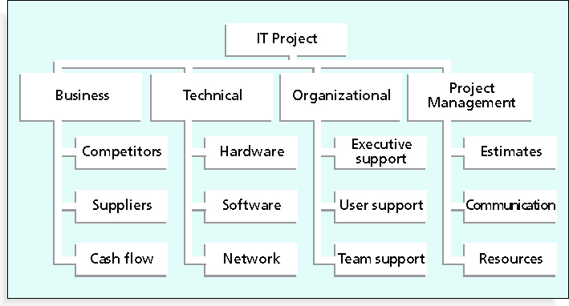
Sample Risk Breakdown Structure

Slide 23

Project Risk Management
OUTPUTS OF RISK IDENTIFICATION
RISK REGISTER
Notes:
Risk Register should include:
List of risks
List of potential responses
Root causes of risks
Updated risk categories

Slide 24
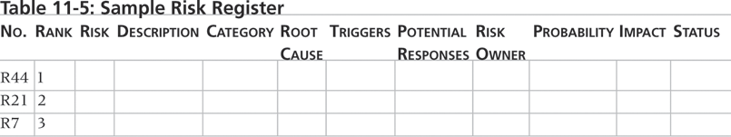
Sample Risk Register

Slide 25
Project Risk Management
Qualitative Risk Analysis
RISK PROBABILITIES AND IMPACT RATING MATRIX
 | Low | Medium | High
Probability (to right) | 0 to 0.33 (probability) | 0.34 to 0.66 (probability) | 0.67 to 1.00 (probability)
Project Objective (below)
Scope (impact) | Minimal changes | Significant changes for functionality | Potential useless product as built
Time (impact) | 5% or less delay | 6% to 15% delay | 16% or greater delay
Cost (impact) | 5% or less increase | 6% to 15% increase | 16% or greater increase
Quality (impact) | Quality slippage minimal | Slippage requires sponsor signoff | Product is basically useless
Notes:
Here is an example:
The criteria or specific thresholds are established by those associated with the project, it could be the sponsors, project manager, or team members.
The project objective row shows the probability range that something could happen. The next four rows show what defines a low, medium or high impact by scope, time, cost and quality.

Slide 26
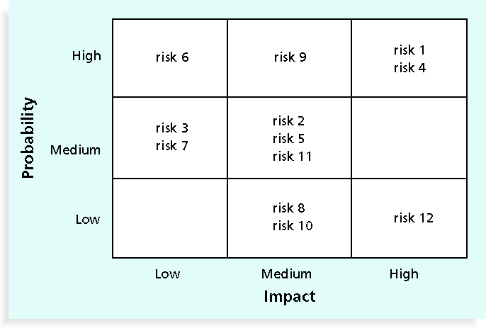
Sample Probability/Impact Matrix

Slide 27
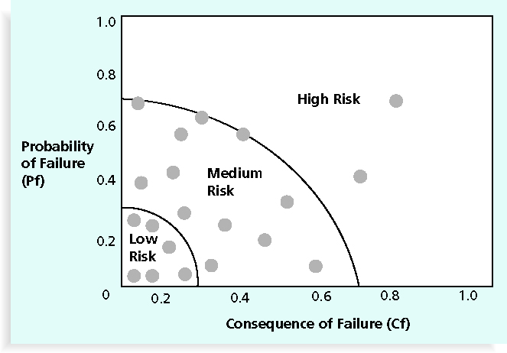
Chart Showing High-, Medium-, and Low-Risk Technologies for fighter jet aircraft

Slide 28
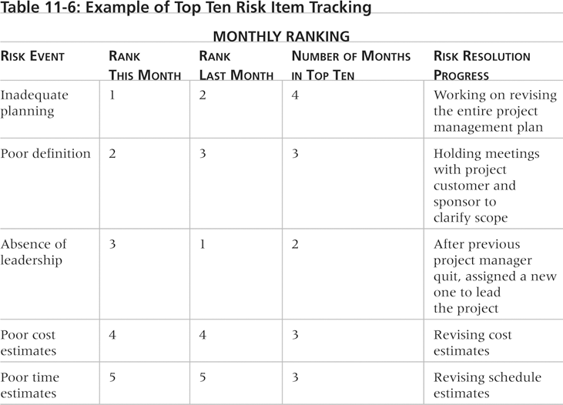
Example of Top Ten Risk Item Tracking

Slide 29
Performing Quantitative Risk Analysis
Often follows qualitative risk analysis, but both can be done together to help in risk analysis
Large, complex projects involving leading edge technologies often require extensive quantitative risk analysis
Main techniques include:
Decision tree analysis
Simulation – (Monte-Carlo)

Slide 30
Project Risk Management
Interviewing
Cost and time estimating
Delphi Technique
Use of historical records from previous projects
Expert judgment
Expected monetary value analysis
Monte Carlo analysis
Notes:
Determining quantitative probability and impact can be determined in the following ways:
Interviewing
Cost and time estimating
Delphi Technique
Use of historical records from previous projects
Expert judgment
Expected monetary value analysis
Monte Carlo analysis

Slide 31
Project Risk Management
EXPECTED MONETARY VALUE ANALYSIS
EXPECTED MONETARY VALUE
Work Package | Probability | Impact | Expected Monetary Value
A | 10% | $20,000 | $2,000
B | 30% | $45,000 | $13,500
C | 68% | $18,000 | $12,240

Slide 32
Project Risk Management
DECISION TREE
Notes:
Decisions trees are primarily used to make decisions regarding individual risks when there is uncertainty.
Decisions trees are used to help make more informed decisions about such things as “how should the work be done?” by taking into account the risks, probability and impact.

Slide 33
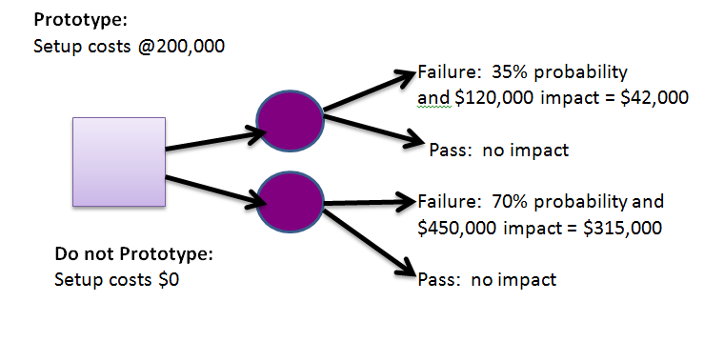
Project Risk Management
Example: Decision Tree
Notes:
What would be cheaper to prototype or not to?

Slide 34
Project Risk Management
Answer: Prototype
Prototype | 35% x $120,000 = $42,000 + $200,000 = $ 242,000
Do Not Prototype | 70% x $450,000 = $315,000

Slide 35
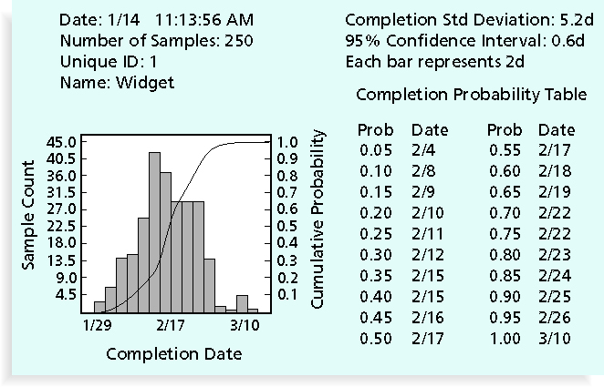
Sample Monte Carlo Simulation Results for Project Schedule

Slide 36
What Went Right?
A large aerospace company used Monte Carlo simulation to help quantify risks on several advanced-design engineering projects, such as the National Aerospace Plan (NASP)
The results of the simulation were used to determine how the company would invest its internal research and development funds
Companies like General Motors, Eli Lily, and Proctor & Gamble have use simulation software

Slide 37
Project Risk Management
RISK RESPONSE PLANNING
What are we going to do about each top risk?
Notes:
Risk response planning is about answering the question:
What are we going to do about each top risk?

Slide 38
Project Risk Management
RISK RESPONSE STRATEGIES
Response strategies for threats.
2. Response strategies for opportunities.
Notes:
Need to develop Risk Response Strategies for threats and opportunities.
Response strategies for threats include:
Avoid – which means eliminate the threat by eliminating the cause.
Mitigate – which means reduce the probability or the impact of a threat, thus making it a smaller risk and removing it from the list of top risks on the project.
Transfer – which means make another party responsible for the risk through purchasing of insurance, performance bonds, warranties, guarantees or outsourcing the work.
2. Response strategies for opportunities include:
Exploit – which means add work or change the project to make sure the opportunity occurs
Enhance – which means to increase the likelihood, probability and positive impact of the risk event.
Share – which means allocate ownership of the opportunity to a third party.
Response strategy for both threats and opportunities is to ACCEPT. – do nothing and say “if it happens, it happens”.

Slide 39
Planning Risk Responses
After identifying and quantifying risks, you must decide how to respond to them
Four main response strategies for negative risks
Risk avoidance
Risk acceptance
Risk transference
Risk mitigation

Slide 40
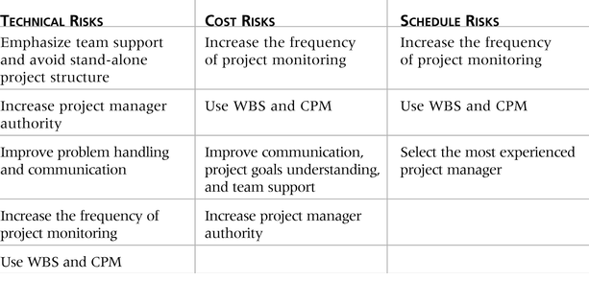
General Risk Mitigation (resolution) Strategies for Technical, Cost, and Schedule Risks

Slide 41
Residual and Secondary Risks
It’s also important to identify residual and secondary risks
Residual risks
are risks that remain after all of the response strategies have been implemented
Secondary risks
are a direct result of implementing a risk response

Slide 42
Monitoring and Controlling Risks
Involves executing the risk management process to respond to risk events
Workarounds
are unplanned responses to risk events that must be done when there are no contingency plans
Main outputs of risk monitoring and control are:
Risk register updates
Organizational process assets updates
Change requests
Updates to the project management plan and other project documents

Slide 43
Project Risk Management

Slide 44

Project Risk Management

